Slide 1
CS 401 – ARTIFICIAL INTELLIGENCE
LECTURE: SEARCHING STRATEGIES

Slide 2
Depth limited search
DFS fails in infinite space or redundant paths
Provide DFS with a limit
Incomplete if limit< d
Not optimal if limit>d

Slide 3
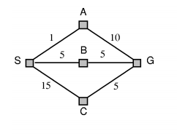
Travel from s to g (uniform cost search example)

Slide 4
Iterative deepening DFS
Finds best depth limit
Combines concept of bfs and dfs
Optimal and complete
Time complexity O(b^{d})

Slide 5
Bidirectional search
Two simultaneous searches
Time and space complexity O(b^{d/2})
Operators are not always reversible

Slide 6
HEURISTIC SEARCH
Heuristics: Rules for choosing the branches in a state space that are most likely to lead to an acceptable problem solution.
Used when:
computational costs are high

Slide 7
Greedy best first search
Evaluation function
Map example
Arad to Bucharest (proves that the algo is not optimal)
Iasi to Fragaras (proves that algo is not complete)

Slide 8
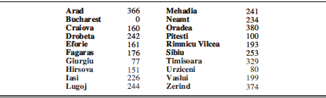
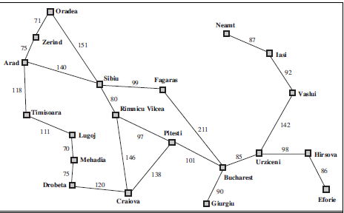

Slide 9
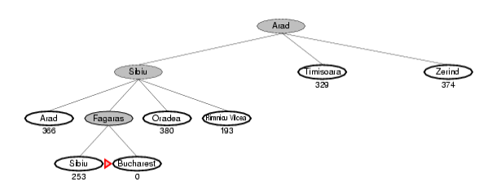
Solution

Slide 10
Missionary and cannibal problem

Slide 11
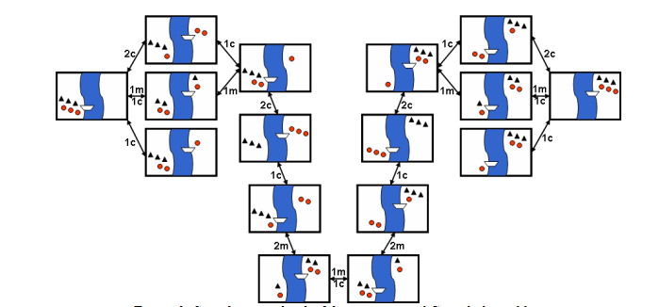
Missionary and cannibal problem-state space example

